Slide 1
ITEC 101 FUNDAMENTALS OF IT
DANIEL OBUOBI, DCSIT,CU
NUMBER SYSTEMS & DATA REPRESENTATION

Slide 2
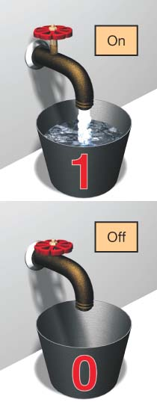
Binary Language
Computers work in binary language
Consists of two numbers: 0 and 1
Everything a computer does is broken down into a series of 0s and 1s
Switches: Devices inside the computer that can be flipped between these two states: 1 or 0, on or off
Notes:
To process data into information, computers need to work in binary language, which consists of two numbers: 0 and 1.
Everything a computer does is broken down into a series of 0s and 1s.
Because modern computers are electronic, digital machines, they understand only two states of existence: on and off. Computers represent these two possibilities, or states, using the digits)1 and 0.
Electronic switches are devices inside the computer that can be flipped between these two states: 1 or 0, on or off.

Slide 3
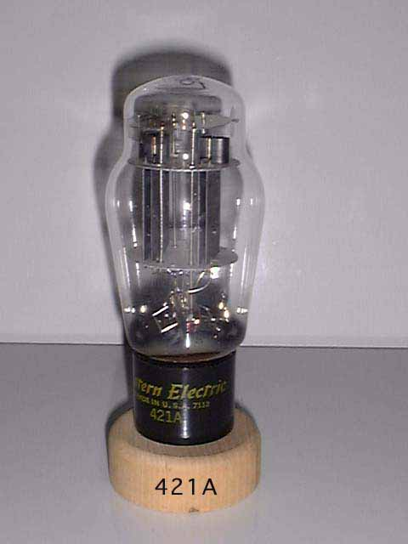
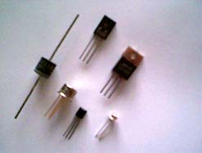
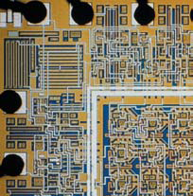
Switches
Non-mechanical devices in computers that open and close circuits
Types of electronic switches:
Vacuum tubes
Transistors:
Semiconductors
Integrated circuits
Vacuum Tube
Transistors
Integrated Circuits
Notes:
Early computers used devices called vacuum tubes as switches. Vacuum tubes act as computer switches by allowing or blocking the flow of electrical current. The problem with vacuum tubes is that they take up a lot of space and they produce a lot of heat. Thus, vacuum tubes make for impractical switching devices in personal computers.
Since the vacuum tubes, two major revolutions have occurred in the design of switches, and consequently computers, to make them smaller and faster: the invention of the transistor and the fabrication of integrated circuits.
Transistors are electrical switches built out of layers of a special type of material called a semiconductor. A semiconductor is any material that can be controlled to either conduct electricity or act as an insulator (to not allow electricity to pass through). Silicon, which is found in common sand, is the semiconductor material used to make transistors.
Integrated circuits (or chips) are very small regions of semiconductor material that support a huge number of transistors. Along with all the many transistors, other components critical to a circuit board (such as resistors, capacitors, and diodes) are also located on the integrated circuit. Most integrated circuits are no more than a quarter inch in size.
Integrated circuits have enabled computer designers to create small yet powerful microprocessors, which are chips that contain a CPU.
.

Slide 4
Switches Representing Data
The on/off state of a switch represents one bit of data
Bit (binary digit)
On = 1
Off = 0
OFF
ON
0
1
OR
= 1 bit
1
0
Notes:
To manipulate the on/off switches, the computer works in binary language, which uses only two digits, 1 and 0.
On is 1 and off is 0. Thus, electricity becomes numbers.

Slide 5
The Binary Number System
Describes a number as powers of 2
Also referred to as base 2 numbering system
Used to represent every piece of data stored in a computer: all of the numbers, letters, and instructions
Notes:
Computers describe a number as powers of 2 because each switch can be in one of two positions: on or off. This numbering system is referred to as the binary number system. It is the number system used by computers to represent all data.
Because it only includes two digits (1 and 0), the binary number system is also referred to as the base 2 number system.
Binary numbers are used to represent every piece of data stored in a computer: all of the numbers, all of the letters, and all of the instructions that the computer uses to execute work.

Slide 6
WHY BINARY?
Computer is an electronic device and hence uses electricity, which can be either on / off.
Devices such as transistors, integrated circuits, semiconductors and cables, can only indicate two states or conditions or signals.
Possible 2 states are:
Transistors are conducting or non-conducting;
Magnetic materials are either magnetized or non-magnetized (polarization)
A pulse or voltage is present or absent.
A current is flowing or not flowing through the circuit
Computer storage uses 2 –state or bi-stable devices (e.g. electric bulb)
All data is represented within the computer by the presence or absence of these various signals.
In a two state on/off arrangement, one state can represent a 1 digit whereas the other as 0 digit.

Slide 7
Representing Data
This two-state situation allows computers to use the binary system to represent data and programs.
In the binary system, each 0 and 1 is called a bit.
Thus, in the computer the 0 represented current being off (or at low voltage) and 1 current being on (or high voltage)
Bits can be grouped in various combinations to represent characters of data-numbers, letters, punctuation marks . ..
A group of 8 bits = 1 byte, and 1 character is represented by 1 byte.
All symbols. Pictures, numbers or words must be reduced to a string of binary digits (one byte) before processing
The binary number system can be used to express any number as a power of 2.
H is a translation of the electronic signal 01001000. Characters on the keyboard are automatically converted into a group of 0’s and 1’s.

Slide 8

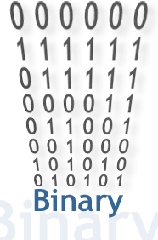
BITS & BYTES

Slide 9
The Binary Number System
Number systems are organized ways to represent numbers
Each number in one system has a corresponding number in another.
 | 128 2x64 | 64 2x32 | 32 2x16 | 16 2x8 | 8 2x4 | 4 2x2 | 2 2x1 | 1
Binary | 0 | 1 | 0 | 1 | 1 | 0 | 0 | 1
Base 10 | 0 + | 64 + | 0 + | 16 + | 8 + | 0 + | 0 + | 1 = | 89
01011001 = 89
Binary Base 10

Slide 10
Representing Letters and Symbols
American Standard Code for Information Interchange (ASCII)
8 bits = 1 byte = alphanumeric character or symbol
256 different combinations
Unicode
16 bits equal 1 byte
65,000 different combinations, used for all languages
01100001 = a
01000001 = A
00100011 = #
01101101 = m
ASCII
Notes:
So you see how to convert numbers from base 10 to base 2, or binary state that the computer understands. Similarly, we need a system that converts letters and other symbols to a binary state.
To provide a consistent means for representing letters and other characters, there are codes that dictate how to represent characters in binary format. Most of today’s computers use the American Standard Code for Information Interchange (ASCII code) to represent each letter or character as an 8-bit (or 1-byte) binary code.
The ASCII code represents the 26 uppercase letters and 26 lowercase letters used in the English language, along with a number of punctuation symbols and other special characters, using 8 bits. Eight bits is the standard length upon which computers are built.
Because it represents letters and characters using only 8 bits, the ASCII code can assign only 256 (or 2⁸) different codes for unique characters and letters. Although this is enough to represent English and many other characters found in the world’s languages, ASCII code cannot represent all languages and symbols.
Thus, a new encoding scheme, called Unicode, was created. By using 16 bits instead of the 8 bits used in ASCII, Unicode can represent more than 65,000 unique character symbols, enabling it to represent the alphabets of all modern languages and all historic languages and notational systems.

Slide 11
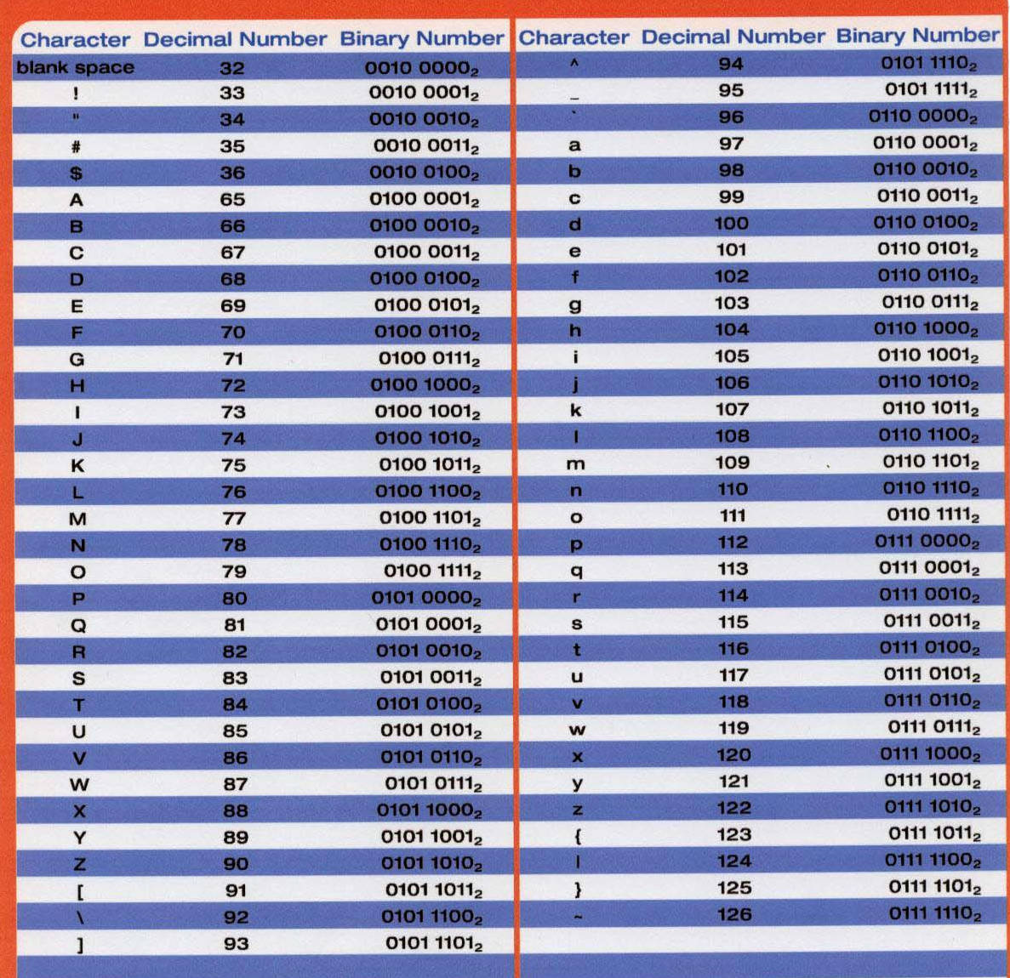
ASCII Chart
Notes:
ASCII stands for the American Standard Code for Information Interchange. It serves as the foundation for electricity becoming information.

Slide 12
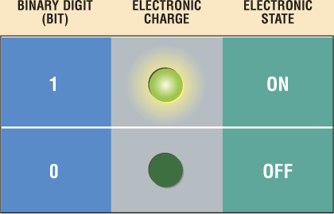
Data Representation
How do computers represent data?
Most computers are digital
Recognize only two discrete states: on or off
Use a binary system to recognize two states
Use Number system with two unique digits: 0 and 1, called bits (short for binary digits)
p. 4.13 Fig. 4-13
Next

Slide 13
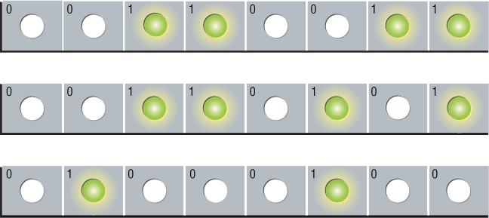
Data Representation
What is a byte?
Eight bits grouped together as a unit
Provides enough different combinations of 0s and 1s to represent 256 individual characters
Numbers
Uppercase and lowercase letters
Punctuation marks
p. 4.13 Fig. 4-14
Next

Slide 14
Data Representation
What are three popular coding systems to represent data?
ASCII—American Standard Code for Information Interchange
EBCDIC—Extended Binary Coded Decimal Interchange Code
Unicode—coding scheme capable of representing all world’s languages
ASCII Symbol EBCDIC
00110000 0 11110000
00110001 1 11110001
00110010 2 11110010
00110011 3 11110011
ASCII = 8 bit system
Therefore 2⁸ = 256 possible combinations
EBCDIC also 8 bit system
UNICODE = 16 bit system
How many possible combinations?
p. 4.14
Next

Slide 15
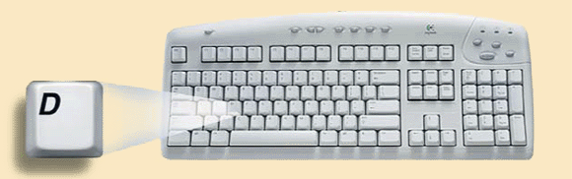
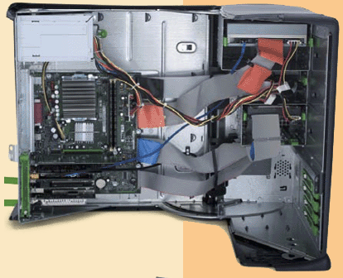

Data Representation
How is a letter converted to binary form and back?
Step 1. The user presses the capital letter D (shift+D key) on the keyboard.
Step 2. An electronic signal for the capital letter D is sent to the system unit.
Step 4. After processing, the binary code for the capital letter D is converted to an image, and displayed on the output device.
Step 3. The signal for the capital letter D is converted to its ASCII binary code (01000100) and is stored in memory for processing.
p. 4.15 Fig. 4-16
Next

Slide 16
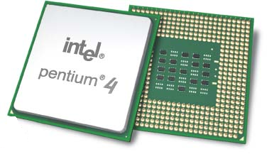
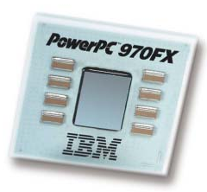
The CPU: Processing Digital Information
CPU is the brains of the computer
Different types of CPUs
Intel and AMD chips: Used in most Windows-based PCs
Apple systems use different CPU design
Differentiating CPUs
Processing power
Clock speed and cache
Notes:
The central processing unit (CPU or processor) executes every instruction given to your computer. The entire CPU fits on a tiny chip, called the microprocessor, which contains all of the hardware responsible for processing information, including millions of transistors.
The CPU is located in the system unit on the computer’s motherboard.
Both Intel and AMD chips are used in the majority of Windows-based PCs. Apple computer systems use a different CPU design. The G4 and PowerPC G5 chip were used by Apple machines for over ten years. In 2005, Apple announced all of their systems would be redesigned to use Intel CPUs.
The primary distinction between CPUs is processing power, which is determined by the number of transistors on each CPU. The greatest differentiators are how quickly the processor can work (called its clock speed) and the amount of immediate access memory the CPU has (called its cache memory).

Slide 17
Processors on the Market Today
Processor | Manufacturer | # of Transistors | Typical Clock Speed | Levels of Cache Storage | Notes
Athlon XP | AMD | 54.3 million | 2.2 GHz | 2 | AMD processor that competes against the Pentium 4
Athlon 64 FX | AMD | 106 million | 2.6 GHz | 2 | 64 bit processor for heavy computation and demanding video gaming needs
Centrino | Intel | 77 million | 2.1 GHz | 2 | Designed specifically for mobile computer: has built-in wireless local network capabilities
Itanium 2 | Intel | 410 million | 1.6 GHz | 3 | Seen in high-end server computers
Pentium 4 Extreme Edition | Intel | 169 million | 3.7 GHz | 3 | The latest version of the Pentium chip. It uses dual cores and hyperthreading to process four tasks at once.
Pentium 4 Processor | Intel | 55 million | 2.6 GHz | 2 | The M is for mobile. The chip uses less power so it can run longer on a battery charge.
PowerPC G4 | Motorola | 57 million | 1.3 GHz | 3 | The only processor that, until 2006, powered the Apple line of computers. (iMac, PowerBooks, and so on)
PowerPC G5 | IBM | 58 million | 2.5 GHz | 2 | Powerful 64-bit processor for heavy computational needs

Slide 18
The CPU Machine Cycle
Fetch
The program’s binary code is “fetched” from its temporary location in RAM and moved to the CPU
Decode
The program’s binary code is decoded into commands the CPU understands.
Execute
The ALU performs the calculations.
Store
The results are stored in the registers
“Inside the Chip” by Intel
Video Clip
Notes:
Any program you run on your computer is actually a long series of binary code, 1s and 0s, describing a specific set of commands the CPU must perform. Each CPU is a bit different in the exact steps it follows to perform its tasks, but all CPUs must perform a series of similar general steps. These steps, referred to as a CPU machine cycle (or processing cycle) are:
1. Fetch: When any program begins to run, the 1s and 0s that make up the program’s binary code must be “fetched” from their temporary storage location in RAM and moved to the CPU before they can be executed.
2. Decode: Once the program’s binary code is in the CPU, it is decoded into the commands the CPU understands.
3 Execute: Next, the CPU actually performs the work described in the command. Specialized hardware on the CPU performs addition, subtraction, multiplication, division, and other mathematical and logical operations at incredible speeds.
4. Store: The result is stored in registers, special memory storage areas built into the CPU, which are the most expensive, fastest memory in your computer. The CPU is then ready to fetch the next set of bits encoding the next instruction.

Slide 19
The System Clock
Located on the motherboard
Controls the CPU’s processing cycles
Clock cycle
Pulse or tick
Clock speed
Number of pulses per second
Measured in hertz (Hz)
Notes:
To move from one stage of the machine cycle to the next, the motherboard contains a built-in system clock.
This internal clock is a special crystal that controls when the CPU moves to the next stage of processing.
These “ticks” of the system clock, known as the clock cycle, set the pace by which the computer moves from process to process.
The pace, known as clock speed, is measured in Hz. Today’s system clocks are measured in GHz, or one billion clock ticks per second.

Slide 20
The Control Unit
Manages the switches inside the CPU
Is programmed by CPU designers to remember the sequence of processing stages for that CPU
Moves each switch to its correct setting (on or off) and then performs the work of that stage
Notes:
The control unit of the CPU manages the switches inside the CPU.
It is programmed by CPU designers to remember the sequence of processing stages for that CPU and how each switch in the CPU should be set, on or off, for each stage.
As soon as the system clock says so, the control unit moves each switch to its correct setting (on or off) and then performs the work of that stage

Slide 21
The Arithmetic Logic Unit (ALU)
Part of the CPU designed to perform mathematical operations (addition, subtraction, multiplication, division, etc.)
Also performs logical OR, AND, and NOT operations
Is fed data from the CPU registers
Word size: Number of bits a computer can work with at a time
Notes:
The arithmetic logic unit (ALU) is the part of the CPU designed to perform mathematical operations such as addition, subtraction, multiplication, and division and to test comparing values as greater than, less than, or equal to.
The ALU also performs logical OR, AND, and NOT operations. The ALU is specially designed to execute such calculations flawlessly and with incredible speed.
The ALU is fed data from the CPU’s registers. The amount of data a CPU can process at a time is based in part on the amount of data each register can hold. The number of bits a computer can work with at a time is referred to as its word size. Therefore, a 64-bit processor can process more information faster than a 32-bit processor.

Slide 22
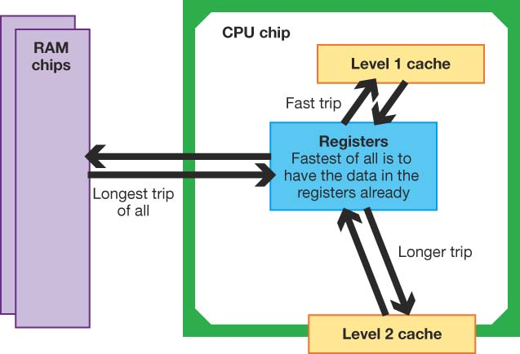
Cache Memory
Small amount of memory located on the CPU chip or near it
Stores recent or frequently used instructions and data
Used for quick access by the CPU
Different levels of cache
Notes:
Cache memory consists of small blocks of memory located directly on and next to the CPU chip.
These memory blocks are holding places for recently or frequently used instructions or data that the CPU needs the most.
When these instructions or data are stored in cache memory, the CPU can more quickly retrieve them than if it had to access the instructions or data in RAM.
Modern CPU designs include a number of types of cache memory. Level 1 cache is a block of memory that is built onto the CPU chip for the storage of data or commands that have just been used. Level 2 cache is located on the CPU chip but is slightly farther away from the CPU, or it’s on a separate chip next to the CPU and therefore takes somewhat longer to access. Some newer CPUs have an additional third level of cache memory storage, called Level 3 cache.

Slide 23
RAM: The Next Level of Temporary Storage
Volatile: When you turn off your computer, the data is erased
Several kinds of RAM exist
Each type of RAM has a different design
Some types work at much faster speeds
Some transfer data more quickly
Notes:
Random access memory (RAM) is volatile, meaning that when you turn off your computer, the data stored in RAM is erased.
There are several kinds of RAM. Each type of RAM has a very different internal design, allowing some types to work at much faster speeds and to transfer data much more quickly than others.

Slide 24
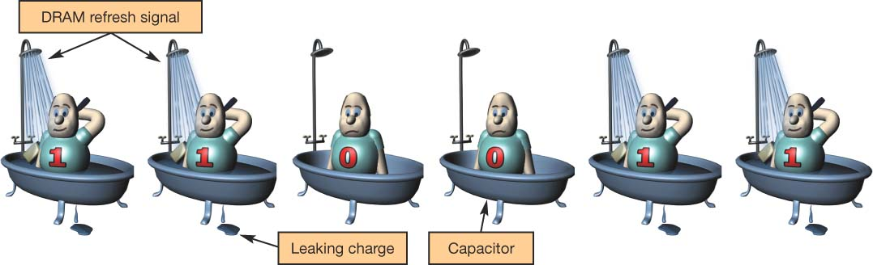
Types of RAM: DRAM
Dynamic RAM (DRAM)
Cheapest and most basic type of RAM
Loses its electrical charge
Needs to be refreshed
Many types of DRAM
SDRAM: Synchronous DRAM
DDR SDRAM: Double data rate SDRAM
Notes:
The cheapest and most basic type of RAM is dynamic RAM (DRAM). It is used in older systems or in systems in which cost is an important factor.
In storing 1 bit of data inside DRAM, a transistor and a capacitor are used. A transistor is a switch that can be turned on or off. A capacitor is a device that acts like a storage space for the charged electrons coming from the transistors. To store a 1, the transistor is turned to the “on” position and it fills the capacitor with charge.
If the capacitor is just filled with charge once, it eventually loses its charge. A 1 bit might now be read as a 0 and the data stored there would be corrupted. To make sure each capacitor holding a 1 value is filled with enough charge to be read as a 1 at any time, a refresh signal is applied. The refresh will flood current through the open transistors to refill the capacitors so they continue to store a valid 1.
A variety of types of DRAM are on the market, each with different performance levels and prices.
-Synchronous DRAM (SDRAM) is much faster than traditional DRAM.
-The current standard of DRAM in home systems is double data rate synchronous DRAM (DDR SDRAM). DDR SDRAM is faster than regular SDRAM but not as fast as DDR2 SDRAM, which is the most recent entry on the market.
Each of these types of DRAM increases the speed with which the CPU can access data, but also increases the cost of the memory modules.

Slide 25
Types of RAM: SRAM
Static RAM (SRAM)
Does not lose its electrical charge
Faster than DRAM
More expensive than DRAM
Used only in locations like cache memory
Notes:
All of the refresh signals required to keep the data “fresh” in DRAM take time. A faster type of RAM is static RAM (SRAM).
In SRAM, more transistors are used to store a single bit, but no capacitor is needed. This eliminates the need for a refresh signal, thus making SRAM much faster than DRAM.
However, because it is more expensive than DRAM, it is used only in locations such as the CPU’s cache, where the system demands the fastest possible storage.

Slide 26
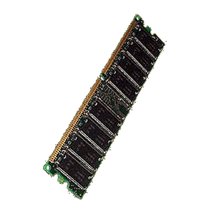
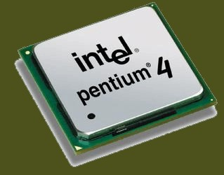
Buses: The CPU’s Data Highway
Bus
Electrical pathway used to move data between components
Local bus: Connects the CPU with the memory
Expansion bus: Connects the CPU with peripheral devices
01100010
01001000
01110011
00100111
Notes:
A bus is an electrical wire in the computer’s circuitry—the highway that data (or bits) travels on between the computer’s various components.
Computers have two different kinds of buses.
-Local buses are on the motherboard and run between the CPU and the main system memory.
- Most systems also have another type of bus, called an expansion bus, which expands the capabilities of your computer by allowing a range of different expansion cards (such as video cards and sound cards) to communicate with the motherboard.

Slide 27
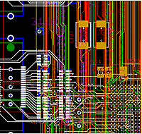
Bus Performance
Bus clock speed
Rate of speed data moves from one location to another
Measured in Mhz (millions of clock cycles per second)
Bus width
The number of bits of data moved on a bus at any one time
Measured in bits
16 bits
32 bits
Notes:
Some buses move data along more quickly than others, whereas some can move more data at one time.
The rate of speed that data moves from one location to another, known as bus clock speed, affects the overall performance of the computer. Bus clock speed is measured in units of megahertz (MHz), or millions of clock cycles per second.
The width of the bus (or the bus width) determines how many bits of data can be sent along a given bus at any one time. The wider the bus, the more data that can be sent at one time. Bus width is measured in terms of bits, so a 32-bit bus can carry more data at one time than a 16-bit bus.

Slide 28
Types of Expansion Buses
ISA and EISA
Found on older computers
Connects mouse, modem, and sound card
PCI
Faster than ISA and EISA
Found on modern computers
Connects network, modem, and sound cards
AGP
Used for three-dimensional graphics
Connects the graphics card and memory
Notes:
Expansion buses provide the pathways that enable the CPU to communicate with the peripheral devices attached through expansion cards.
Expansion buses have evolved to provide faster transfer speeds and wider bit widths to deliver higher data transfer rates to the many peripheral devices you may connect to your computer.
There are several types of expansion buses.
-Older computers include buses such as the Industry Standard Architecture (ISA) bus and the Extended Industry Standard Architecture (EISA) bus to connect devices such as the mouse, modem, and sound cards. These are being replaced by faster, more efficient connections.
-In a modern computer system, you’ll find Peripheral Component Interconnect (PCI) buses. PCI expansion buses connect directly to the CPU and support such devices as network cards and sound cards.
-On current systems, you’ll also find Accelerated Graphics Port (AGP) buses. The AGP bus design was specialized to help move three-dimensional graphics data quickly. It establishes a direct pathway between the graphics card and main memory so that data does not have to ride on the PCI bus, clogging up other system data being moved about.

Slide 29
Moore’s Law
Number of transistors on a CPU will double every 18 months
First chip had 29,000 transistors
Pentium chip 169,000,000 transistors
Moore’s Law has been accurate for 25 years
Notes:
Gordon Moore, the cofounder of processor manufacturer Intel, predicted more than 25 years ago that the number of transistors on a processor would double every 18 months. Known as Moore’s Law, this prediction has been remarkably accurate—but only with tremendous engineering ingenuity. The first 8086 chip had only 29,000 transistors and ran at 5 MHz. Advances in the number of transistors on processors through the 1970s, 1980s, and 1990s continued to align with Moore’s prediction.

Slide 30
Making Computers Faster
Pipelining: The CPU processes more than one instruction at a time
Non-pipelined CPU
Instruction 1
Fetch
Decode
Execute
Store
Instruction 2
Fetch
Decode
Execute
Store
Pipelined CPU
Instruction 1
Fetch
Decode
Execute
Store
Instruction 2
Fetch
Decode
Execute
Store
Instruction 3
Fetch
Decode
Execute
Store
Instruction 4
Fetch
Decode
Execute
Store
Notes:
One method found to speed up a CPU is called pipelining.
As an instruction is processed, the CPU runs through the four stages of processing in a sequential order: fetch, decode, execute, store. Pipelining is a technique that allows the CPU to work on more than one instruction (or stage of processing) at a time, thereby boosting CPU performance. and is used in some fashion in all modern CPUs.
Instead of the CPU carrying out one step of the machine cycle on every pulse of the system clock, the CPU performs different parts of the cycle simultaneously, theoretically making the CPU four times faster. Chip makers have also designed special instruction sets to handle multimedia content, again speeding up the overall performance of the system.

Slide 31
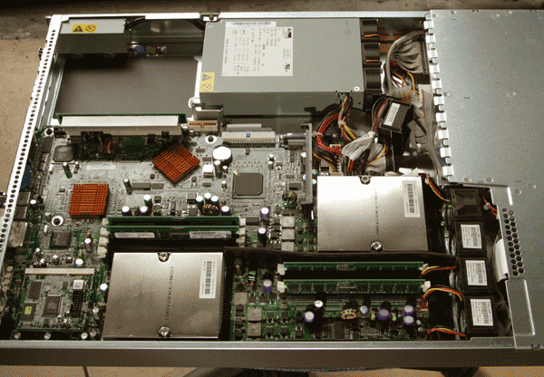
Making Computers Faster
Dual processing
Two CPUs on the same system
Each processor shares the workload
Parallel processing
Network of computers
Each computer works on a portion of the problem simultaneously
Dual processors
Notes:
Although the vast majority of home and work desktop systems today use only one processor, it is becoming increasingly common to use dual processors. A dual-processor design has two separate CPU chips installed on the same system. Operating systems such as Windows XP Professional and Apple’s Mac OS X are able to work with dual processors and automatically decide how to share the workload between them.
Certain types of problems are well suited to a parallel-processing environment. In parallel processing, there is a large network of computers, with each computer working on a portion of the same problem simultaneously. To be a good candidate for parallel processing, a problem must be one that can be divided into a set of tasks that can be run simultaneously. If the next step of an algorithm can be started only after the results of the previous step have been computed, parallel processing will present no advantages.

Slide 32
NOW

Slide 33
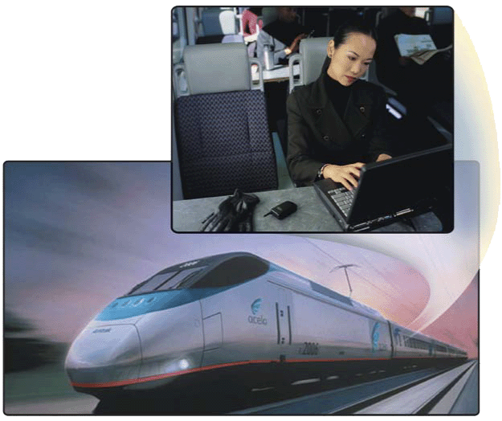
Memory
What is memory?
Seat #2B4
Seat #2B3
Electronic components that store instructions, data, and results
Consists of one or more chips on motherboard or other circuit board
Each byte stored in unique location called an address, similar to addresses on a passenger train
p. 4.15 Fig. 4-17
Next

Slide 34
Memory
How is memory measured?
By number of bytes available for storage
Term Abbreviation Approximate Size
Kilobyte KB or K 1 thousand bytes
Megabyte MB 1 million bytes
Gigabyte GB 1 billion bytes
Terabyte TB 1 trillion bytes
p. 4.16 Fig. 4-18
Next

Slide 35
Memory
What is random access memory (RAM)?
Memory chips that can be read from and written to by processor
Also called main memory or primary storage
Most RAM is volatile, it is lost when computer’s power is turned off
The more RAM a computer has, the faster it responds
p. 4.17
Next

Slide 36




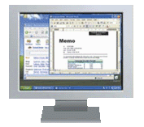
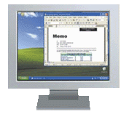
Memory
How do program instructions transfer in and out of RAM?
RAM
Step 1. When you start the computer, certain operating system files load into RAM from the hard disk. The operating system displays the user interface on the screen.
Operating system instructions
Operating system interface
Step 2. When you start a Web browser, the program’s instructions load into RAM from the hard disk. The Web browser window is displayed on the screen.
Web browser instructions
Web browser window
Step 3. When you start a word processing program, the program’s instructions load into RAM from the hard disk. The word processing program, along with the Web Browser and certain operating system instructions are in RAM. The word processing program window is displayed on the screen.
Word processing program instructions
Word processing program window
RAM
Step 4. When you quit a program, such as the Web browser, its program instructions are removed from RAM. The Web browser no longer is displayed on the screen.
Web browser program instructions are removed from RAM
Web browser window no longer is displayed on desktop
p. 4.17 Fig. 4-19
Next

Slide 37
Memory
What are two basic types of RAM chips?
Most common type
Used for special applications such as cache
Static RAM (SRAM)
Dynamic RAM (DRAM)
Faster variations of DRAM are SDRAM and RDRAM
Faster and more reliable than DRAM chips
p. 4.18
Next
Notes:
Dynamic RAM (DRAM) must re

Slide 38
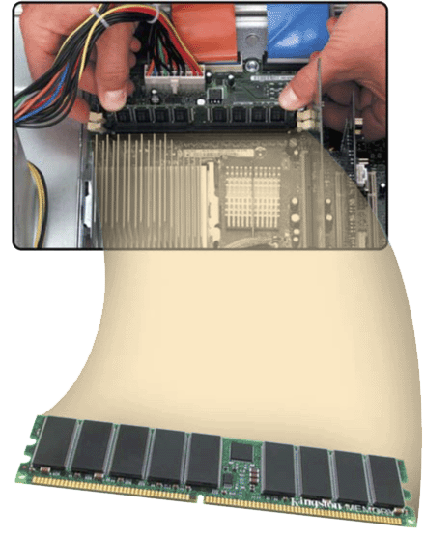
Memory
dual inline memory module
Where does memory reside?
Resides on small circuit board called memory module
Memory slots on motherboard hold memory modules
memory chip
memory slot
p. 4.18 Fig. 4-20
Next

Slide 39
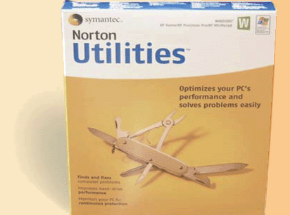
Memory
How much RAM does an application require?
Software package typically indicates RAM requirements
For optimal performance, you need more than minimum specifications
System Requirements
Windows® XP Home Edition/Professional
Intel Pentium processor at 233MHZ or higher
AMD K6 (Athlon Duron Family processor at 233MHZ or higher
64 MB of RAM
Note: listings of RAM requirements are MINIMUMS to enable program to function. Most needs to run efficiently are MUCH higher.
p. 4.19 Fig. 4-21
Next

Slide 40
Memory
How much RAM do you need?
Depends on type of applications you intend to run on your computer
RAM
128 to 256 MB
256 to 1 GB
1 GB and up
Use
Home and business users managing personal finance
Using standard application software such as word processing
Using educational or entertainment CD-ROMs
Communicating with others on the Web
Users requiring more advanced multimedia capabilities
Running number-intensive accounting, financial, or spreadsheet programs
Using voice recognition
Working with videos, music, and digital imaging
Creating Web sites
Participating in video conferences
Playing Internet games
Power users creating professional Web sites
Running sophisticated CAD, 3D design, or other graphics-intensive software
p. 4.19 Fig. 4-22
Next

Slide 41
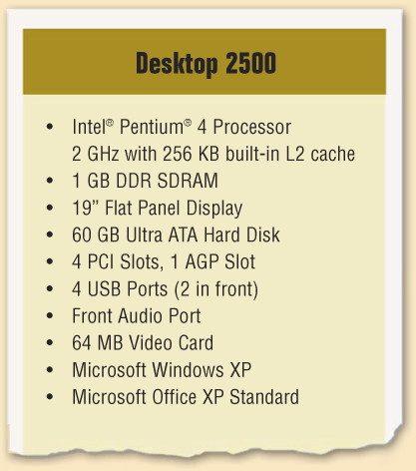
Memory
What is cache?
Helps speed computer processes by storing frequently used instructions and data, which is data in a page of memory
Also called memory cache
L1 cache built into processor. Capacity 8 -128 KB
L2 cache slower but has larger capacity about 64 KB to 4 MB. This is used by older PCs and is on the motherboard
L2 advanced transfer cache is faster, built directly on processor chip and used by current processors
L3 cache is separate from processor chip on motherboard (L3 is only on computers that use L2 advanced transfer cache)
What is order of searching for data in RAM by the CPU?
p. 4.20 Fig. 4-23
Next

Slide 42
Memory
What is read-only memory (ROM)?
Memory chips that store permanent data and instructions
Nonvolatile memory, it is not lost when computer’s power is turned off
Three types:
Firmware— Manufactured with permanently written data, instructions, or information
EEPROM (electrically erasable programmable read-only memory)— Type of PROM containing microcode programmer can erase
PROM (programmable read-only memory)— Blank ROM chip onto which a programmer can write permanently
p. 4.20
Next

Slide 43
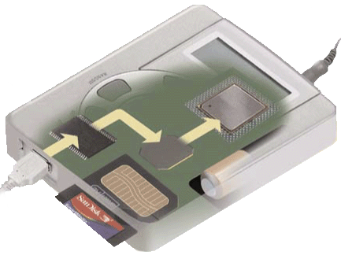
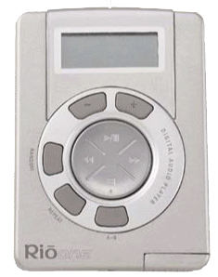
Memory
What is flash memory?
Nonvolatile memory that can be erased electronically and reprogrammed
Used with PDAs, digital cameras, digital cellular phones, music players, digital voice recorders, and pagers
Step 3. Plug the headphones into the MP3 player, push a button on the MP3 player, and listen to the music through the headphones.
Step 1. Purchase and download MP3 music tracks from a Web site. With one end of a special cable connected to the system unit, connect the other end into the MP3 player.
To headphones
Flash memory chip
From computer
Flash memory card
Step 2. Instruct the computer to copy the MP3 music track to the flash memory chip in the MP3 player.
MP3 Player
p. 4.21 Fig. 4-24
Next

Slide 44
Memory
What is CMOS Memory?
Complementary metal-oxide semiconductor memory
Used in some RAM chips, flash memory chips, and other types of memory chips
Uses battery power to retain information when other power is turned off
Stores date, time, and computer’s startup information
p. 4.22
Next

Slide 45

Memory
What is access time?
Amount of time it takes processor to read data from memory
Measured in nanoseconds (ns), one billionth of a second
It takes 1/10 of a second to blink your eye; a computer can perform up to 10 million operations in same amount of time
Term Speed
Millisecond One-thousandth of a second
Microsecond One-millionth of a second
Nanosecond One-billionth of a second
Picosecond One-trillionth of a second
p. 4.22 Fig. 4-26
Next

Slide 46
CODING SCHEMES

Slide 47
THE BINARY SYSTEM
Uses base 2 (digits are 0, 1)
Binary fractions are separated from whole portion of the number by binary point.
For example given 101011.11
101011.11 base 2 = 1*32 + 0*16 +1*8 + 0*4 + 1*2 + 1*1 + 1*0.5 + 1*0.25 = 43.75
This is equivalent to
43.75 base 10 = 4*10 + 3*1 + 7*0.1 + 5*0.01 = 43.75

Slide 48
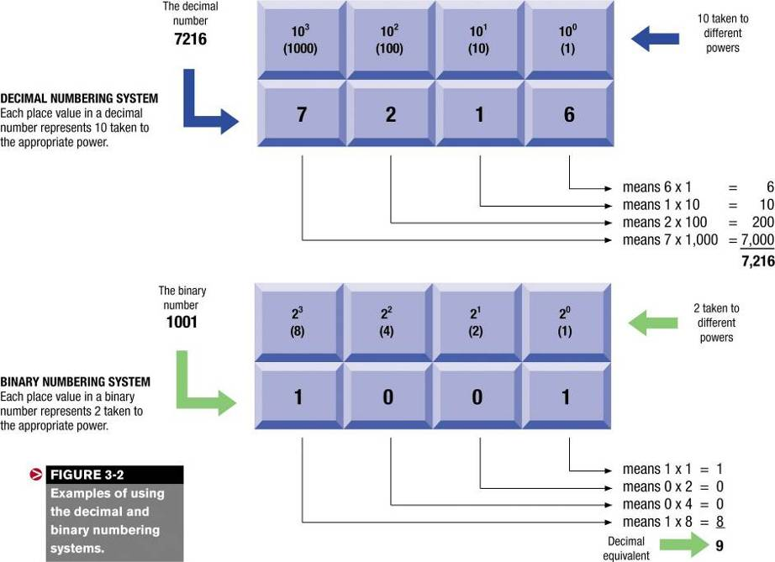
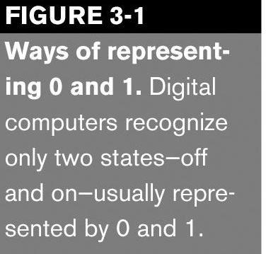

Slide 49
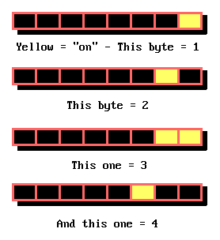
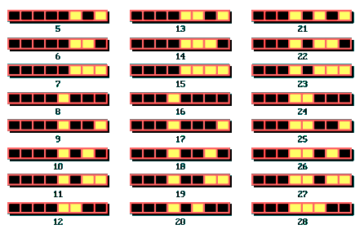
COUNTING WITH BINARY

Slide 50

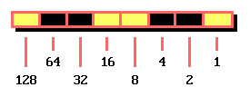
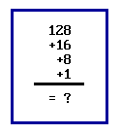
Example
Consider this
Remember that the rightmost position, if "on" is worth 1
Work out

Slide 51
OCTAL & HEXADECIMAL SYSTEM
Binary system length and monotony makes dealing with them tedious and error prone.
The compromise between binary and decimal system is the octal and the hexadecimal system.
The Octal system
uses base 8 (digits 0 through 7). A convenient shorthand for binary
7250 base 8 = 111 010 101 000 base 2 = 111010101000
The Hexadecimal system
Use base 16, the possible digits are 0 – 9, A - F
Using letters A – F as number is strange but it is necessary in order to have a single character to represent values 10 through 15 to avoid confusion.
Each hexadecimal digit is equivalent to 4 binary digits

Slide 52
HEXADECIMAL SYSTEM
Example
EA8 = 8 * 1 + 10* 16 + 14 * 16* 16 = 8 + 160 + 3584 = 3752
Since each hexadecimal digits = 4 binary digits
EAB = 1110 1010 1000
Hence hexadecimal is a shorthand way of expressing binary numbers.
The computer cannot use true binary because,
in addition to representing numbers, alphabets and symbols etc must be represented. This requirement led to the development of coding schemes.

Slide 53
Representing Letters and Symbols
American Standard Code for Information Interchange (ASCII)
8 bits = 1 byte = alphanumeric character or symbol
256 different combinations
Unicode
16 bits equal 1 byte
65,000 different combinations, used for all languages
See more later
01100001 = a
01000001 = A
00100011 = #
01101101 = m
ASCII
Notes:
So you see how to convert numbers from base 10 to base 2, or binary state that the computer understands. Similarly, we need a system that converts letters and other symbols to a binary state.
To provide a consistent means for representing letters and other characters, there are codes that dictate how to represent characters in binary format. Most of today’s computers use the American Standard Code for Information Interchange (ASCII code) to represent each letter or character as an 8-bit (or 1-byte) binary code.
The ASCII code represents the 26 uppercase letters and 26 lowercase letters used in the English language, along with a number of punctuation symbols and other special characters, using 8 bits. Eight bits is the standard length upon which computers are built.
Because it represents letters and characters using only 8 bits, the ASCII code can assign only 256 (or 2⁸) different codes for unique characters and letters. Although this is enough to represent English and many other characters found in the world’s languages, ASCII code cannot represent all languages and symbols.
Thus, a new encoding scheme, called Unicode, was created. By using 16 bits instead of the 8 bits used in ASCII, Unicode can represent more than 65,000 unique character symbols, enabling it to represent the alphabets of all modern languages and all historic languages and notational systems.

Slide 54
CODING SCHEMES
EBCDIC (ib-si-dick)
1 byte per character, Used on IBM mainframes
ASCII
1 byte per character, Used on PCs and larger computers
Unicode
2 bytes per character, Allows characters from languages other than English
computer system encodes the data by means of binary, or digital, coding schemes

Slide 55
EBCDIC
EBCDIC (Extended Binary Coded Decimal Interchanged Code)
Commonly used in IBM mainframes.
EBCDIC is an 8-bit coding scheme representing 256 (2⁸) characters. That is 256 possible bit combinations.
It can be used to represent uppercase letters, lowercase letters, decimal digits, punctuation marks and special characters.
A unique combination of the above represent each character.

Slide 56
ASCII
ASCII (American Standard Code for Information Interchange)
The most widely used binary code with non-IBM mainframes and virtually all microcomputers.
The standard ASCII uses a 7 bits code, limiting its character set to 128 (27).
The more common extended ASCII uses 8 bits generating 256(2⁸) unique characters.

Slide 57
ASCII Chart
Notes:
ASCII stands for the American Standard Code for Information Interchange. It serves as the foundation for electricity becoming information.

Slide 58
UNICODE
ASCII cannot handle all the characters eg Chinese and Japanese.
Unicode, which was developed to deal with such languages,
uses 2 bytes (16 bits) for each character, instead of 1 byte (8 bits).
It therefore can handle 65, 536 character combinations rather than just 256.
Each Unicode character takes up twice as much memory space and disk space as each ASCII character
Conversion to the Unicode standard seems likely. However, because most existing software applications and databases are yet to utilize Unicode, hence conversion will take time

Slide 59
Coding Systems for Text-Based Data
ASCII and EBCDIC
Fixed-length codes that can represent any single character of data as a string of eight bits.
Unicode
A longer (32 bits per character is common) code that can be used to represent text-based data in virtually any written language.

Slide 60
Coding Systems for Other Types of Data
Graphics data—often stored as a bitmap which the color to be displayed at each pixel stored in binary form.
Audio data—waveform audio is common; MP3 compression makes audio files much smaller.
Video data—requires a great deal of storage space, but can be compressed.

Slide 61
PARITY BIT
Dust, electrical disturbance, weather conditions, and other factors can cause interference in a circuit or communication line that is transmitting a byte.
Detections of error in data transmitted is accomplished by the use of parity bit,
It is an extra bit attached to the end of a byte for purposes of checking for accuracy.
The additional bit is used to indicate any changes in that number during transmission.
The parity scheme used for detecting single bit error is simple, but the detecting of multiple bit errors is more complex
Parity Schemes may be even parity or odd parity

Slide 62
EVEN PARITY
Works by counting the numbers of 1’s in a binary number and,
If that numbers is odd, add an additional (Parity) 1 to guarantee that the total number of 1’s is even. Hence the parity is 1
If that number is even, a parity bit of 0 is added to make it even. Hence the parity bit is 0.
Try the letter H (01001000)

Slide 63
ODD PARITY
Works in a similar manner but it guarantees that the total number of 1’s is an odd n umber.
The parity bit is set to 1 or 0 such that there is an odd number of binary 1’s in the group.
The system software in computer automatically and continually checks the parity scheme for accuracy.
In extremely corrupt situation, it can fail so another method is used e.g. check digits

Slide 64
Example 1
ASCII-8 bits (Parity bit) Even Parity
H 01001000 0 = 2 bits
E 01000101 1 = 4 bits
R 01010010 1 = 4 bits
O 01001111 1 = 6 bits
The sum of bits is even, ➔ the byte is okay.
Therefore no re-transmission
Error In Transmission
H 01001001 0 = 3bits
The sum of bits is odd, ➔ the byte is not okay.

Slide 65
Example 2
ASCII-8 bits (Parity bit) Odd Parity
H 01001000 1 = 3 bits
E 01000101 0 = 3 bits
R 01010010 0 = 3 bits
O 01001111 0 = 5 bits
The sum of bits is odd, ➔ the byte is okay.
Therefore no re-transmission
Error In Transmission
H 01001001 1 = 4bits
The sum of bits is even, ➔ the byte is not okay.

Slide 66
CHECK SUM
When the sender is about to send a data,
it runs a special algorithm against the binary data and computes what is known as a checksum.
This checksum is then appended to data being transmitted.
When the recipient receives the data,
It decodes the entire data stream and runs a similar algorithm against the data portion.
The recipient compares the value that it computed to the value contained in the received checksum.
If the values are different, it rejects the data and asked it to be retransmitted.
Most error checking done today uses check summing.

